Slide 1
DBDA.X408 – Introduction to Machine Learning and Data Mining
Instructor: Oswald Campesato
Movie Revenue Prediction
Christabelle Peter
Hsuan Ju Liu
Yu Chen Ku
Kai Kwan(Carven), Poon

Slide 2

Objective:
The goal of this project was to predict the revenue of the movies based on their features

Slide 3
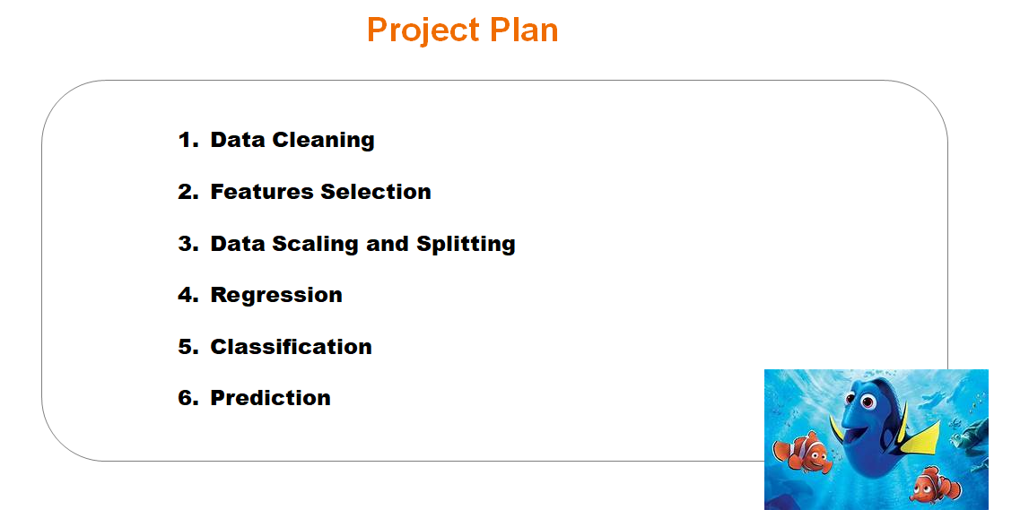

Slide 4
Data Cleaning
JSON format
Dropping Null & NA columns
Dropping Unnecessary Columns
Converting data into numeric label types
Statistics of each features

Slide 5
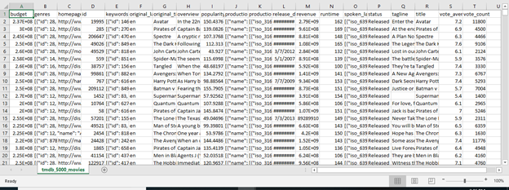
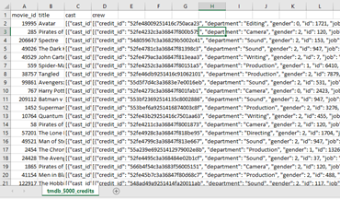
Dataset : 2 csv files
We combined two csv into one
Tmdb_5000_movies.csv
4804 rows / 20 columns
Tmdb_5000_credits.csv
4814 rows / 4 columns

Slide 6
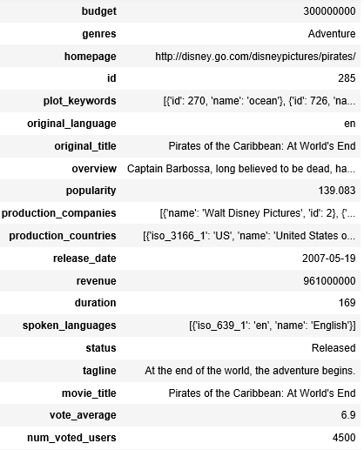
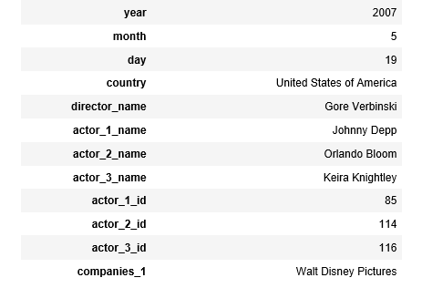
Dataset : 2 csv files
Some of the columns are in JSON format
We extracted them into columns
4803 rows, 32 columns

Slide 7
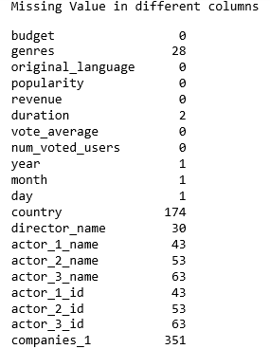
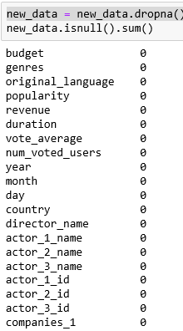
Dataset : Dropping Null & NA columns
We dropped empty & NA cells

Slide 8
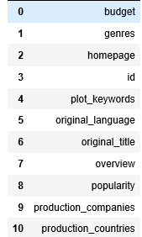
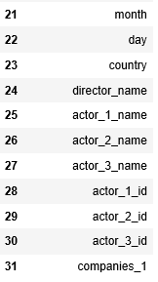


Dataset : Dropping Unnecessary Columns
We dropped 12 columns
Id
homepage
overview
spoken_languages
status
tagline
original_title
production_companies
production_countries
movie_title
release_date
plot_keywords
4411 rows, 20 columns

Slide 9
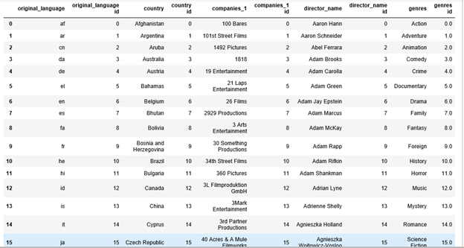
Dataset: Converting data into numeric label types
Table of label & Data
We converted categorical data into numeric labels by using the function LabelEncoder
original_language
country
companies_1
director_name
genres

Slide 10
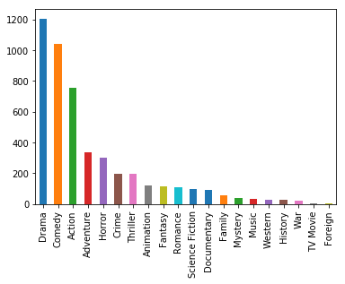
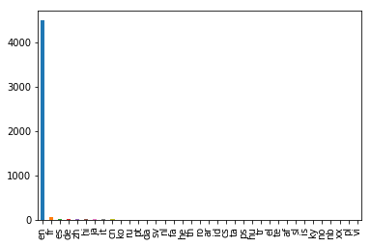
Dataset: Analysis & Visualization
Analysis & Visualization for features
genres
original_language
The most popular genre is drama.
The most original_language is English.

Slide 11
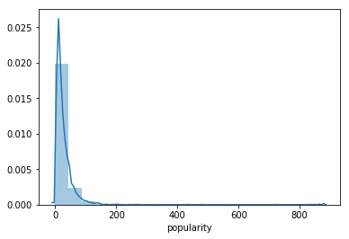
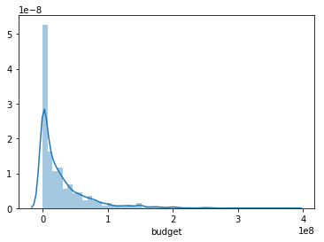
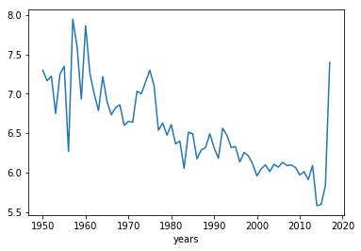
Dataset: Analysis & Visualization
Analysis & Visualization for features
popularity
budget
Vote average

Slide 12
Features Selection
Use PCA to calculate number of features to select
Find correlation of features with target
Reduce the dimension of feature set

Slide 13
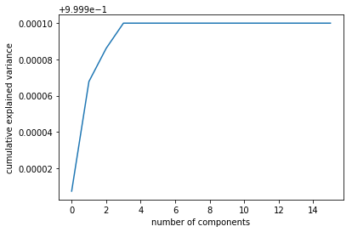
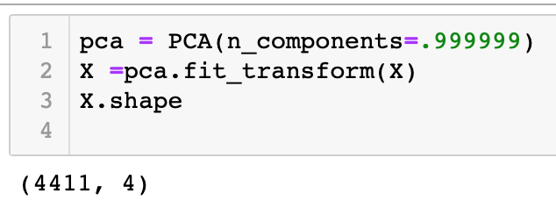
Choose the number of features
We used PCA to find the number of features to select
Cover 99.9999% of Variance

Slide 14
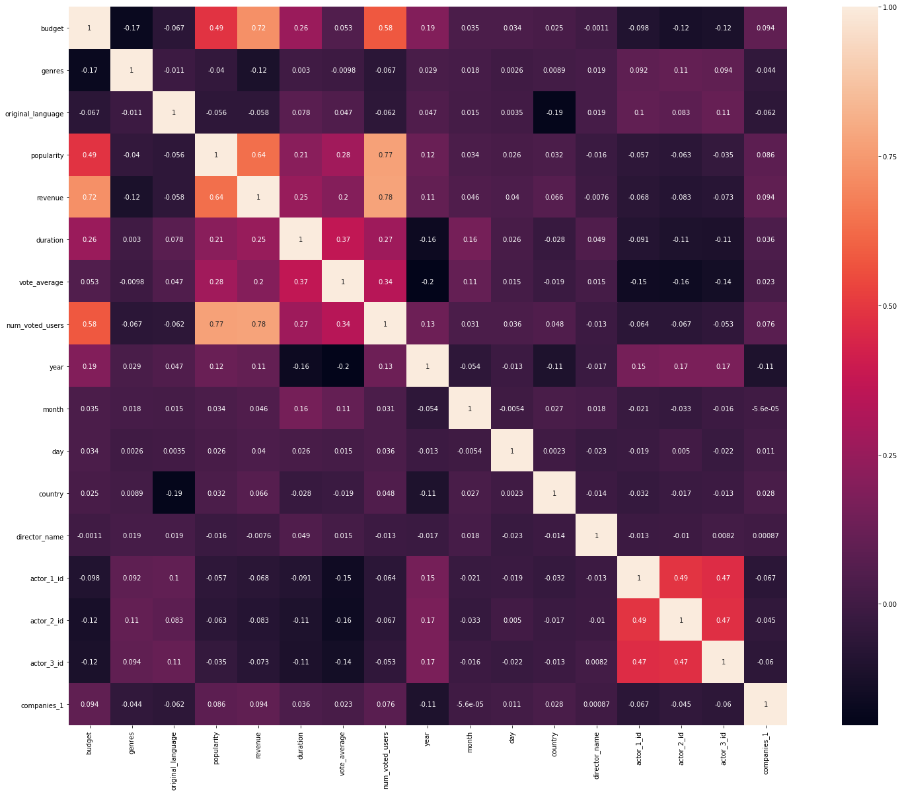
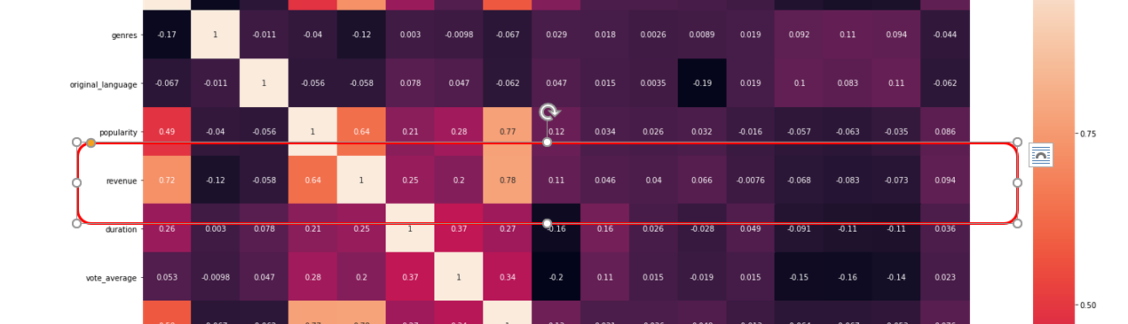
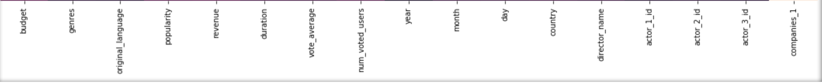
Correlation
Use Heat map to see the correlation between features

Slide 15
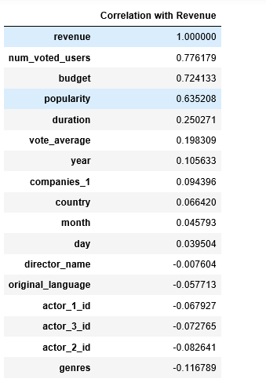
Correlation of features
with revenue
After the PCA, we selected Top 4 features:
Number of voted users
Budget
Popularity
Duration
16 -> 4

Slide 16
Data Preparing

Slide 17
Data Preparing
Split dataset into 80/20
Scale the X

Slide 18
Regression
Linear Regression
KNeighbors Regression
Decision Tree Regression
Random Forest Regression
Gradient Boosting Regression
Kernel Ridge Regression

Slide 19
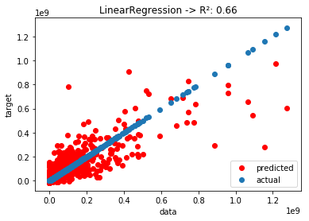
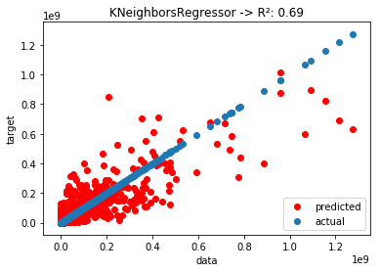
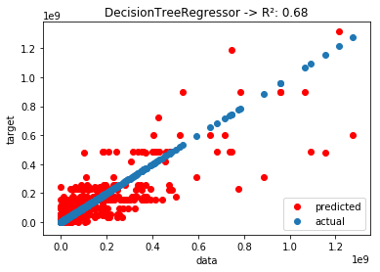
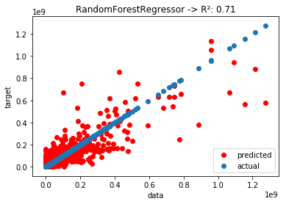



Slide 20
Classification
Random Forest
Naïve Bayes
SVM
Decision Tree

Slide 21
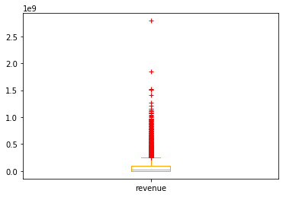
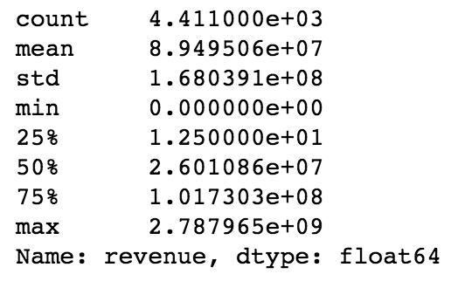
Revenue

Slide 22
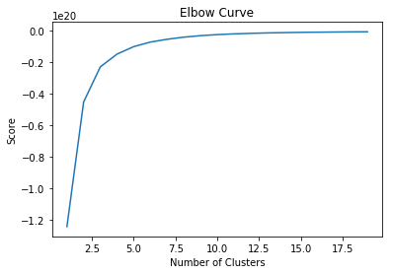
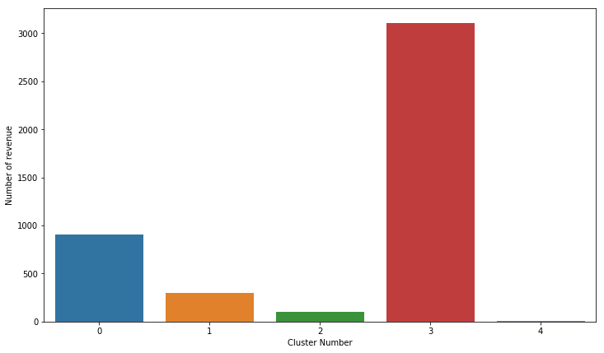
Using Kmeans to do clustering
# of movies in these 5 cluster

Slide 23
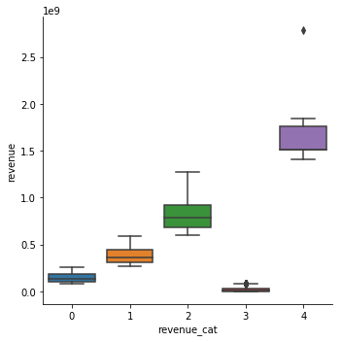
Label revenue into five categories
cluster | raws | min | max
0 | 904 | 82,394,288 | 261,930,431
1 | 296 | 263,920,180 | 591,794,936
2 | 102 | 599,045,960 | 1,274,219,009
3 | 3103 | 0 | 82,169,884
4 | 6 | 1,405,403,694 | 2,787,965,087
Use this info to create a new columns for classification

Slide 24
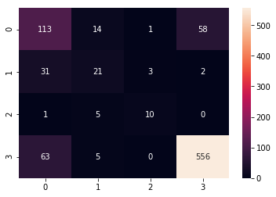
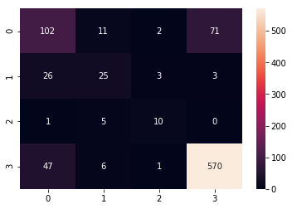
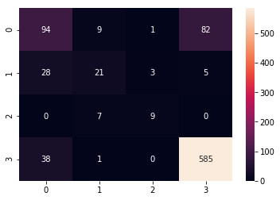
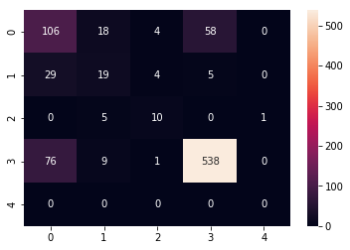
Random Forest: 0.79
Naive Bayes: 0.80
SVM: 0.80
Decision Tree: 0.76

Slide 25
Summary of Model Evaluation
Classifier models | Accuracy
Random forest | 0.79
SVM | 0.80
Decision Tree | 0.80
Naive Bayes | 0.76
Regression models | R_Square
Random Forest Regression | 0.71
Gradient Boosting Regression | 0.7
KNeighbors Regression | 0.69
Decision Tree Regression | 0.68
Kernel Ridge | 0.67
Linear Regression | 0.66
80% Accuracy
R_Square: 0.7

Slide 26
Prediction and Conclusion
Prediction

Slide 27

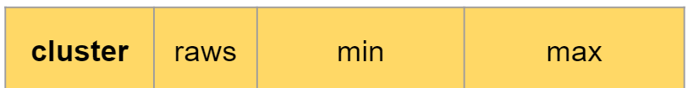
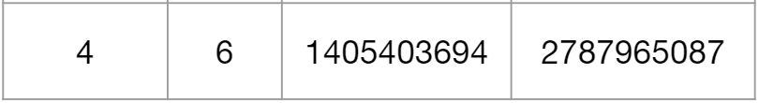
Prediction with Classification
Classification Prediction: SVM
Actual Revenue
$1,405,403,694

Slide 28
Conclusion
We tried to run the classification and regression model for prediction
Classification gave us the range of the revenue
Regression gave us the exact number of the revenue
We believe classifier model is the most reliable model among the rest

Slide 29
Q & A

